Slide 1
CECS 450
Data Visualization
PHASE 1
PRESENTED BY:
TEAM 3

Slide 2
Goal of the project
To generate interactive visualization(s) of a given dataset that captures gaze behavior recorded during a human-computer interaction session.
Libraries Used:
Plotly
D3.js

Slide 3
QUESTIONS
What is the time duration of fixation?
When the user looks for too long, maybe the information was difficult to process
What is the fixation pattern over time?
What is the most important path of the user.
In which quadrants, does the fixation points lie the most?
If there is any area with more fixation points, then maybe less space is needed to display the information
Which fixation quadrants have the most click events?
How much is each quadrants viewed or clicked?

Slide 4
Data Preprocessing
Language: Python
In Gaze data, we deleted inconsistent data having validity code as 0 and 4 on each side and anything above 2 on both sides.
Merged Fixation and Gaze data using Left Join on the column-Time.

Slide 5
Data Preprocessing
Deleted “Event” and “Description” columns from Event Data.
In Event data, we assumed that when the user uses the keyboard the camera loses the focus of the user’s eye. Thus, the data is will return an incorrect reading.
5. Merged Event and Fixation Data on “Time”

Slide 6
Results from Data Preprocessing
No. | Process | Graph Visualization | Tree Visualization
1 | Total Gaze Data Points | 145095 | 31587
2 | Total Fixation Points | 7967 | 1564
3 | Total Events | 1061 | 277
4 | Gaze_Fixation Merged Data Points | 392 | 84
5 | Event_Fixation Merged Data Points | 5 | 1
6 | Event_Gaze Merged Data Points | 48 | 4
7 | Mouse Clicks | 892 | 173
8 | Keyboard clicks | 169 | 104

Slide 7
VISUALIZATIONS
Plotly
D3.js

Slide 8
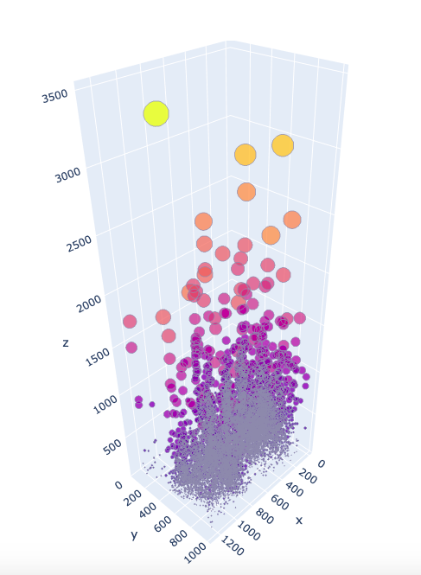
1.a What is the time duration of fixation? (Graph)
In this graph, we have plotted a 3D scatter plot using x and y-coordinates of the screen with duration on the z axis. The size and color of the data points is based on Duration of the data.

Slide 9
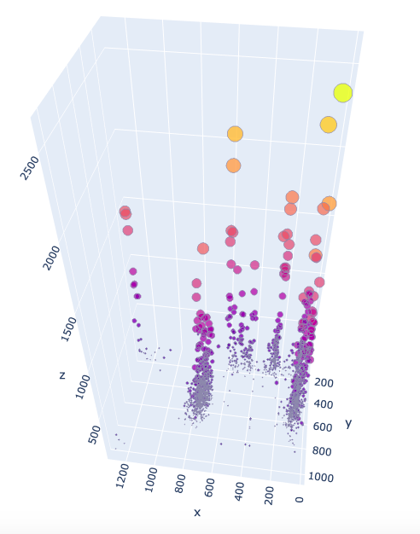
1.b What is the time duration of fixation? (Tree)
In this graph, we have plotted a 3D scatter plot using x and y-coordinates of the screen with duration on the z axis. The size and color of the data points is based on Duration of the data.

Slide 10
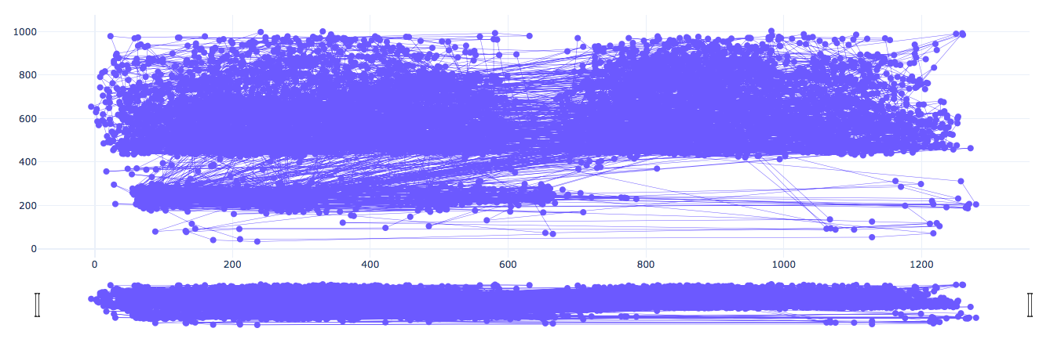
2.a What is the fixation pattern over time? (Graph)
To find the fixation pattern pattern over time, we decided to plot the x data points v/s y data points along with a range slider.

Slide 11
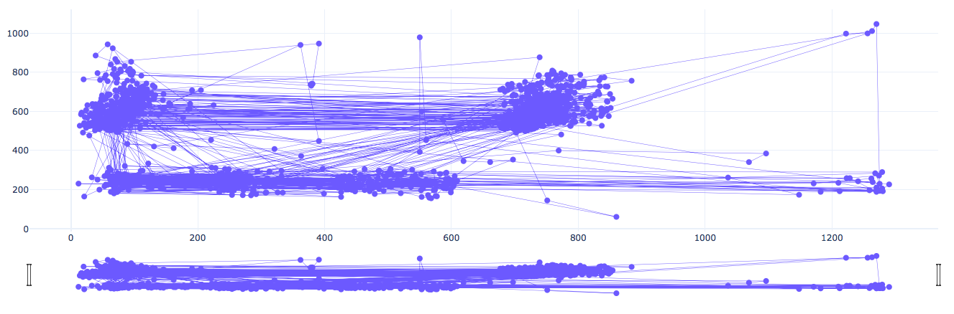
2.b What is the fixation pattern over time? (Tree)

Slide 12
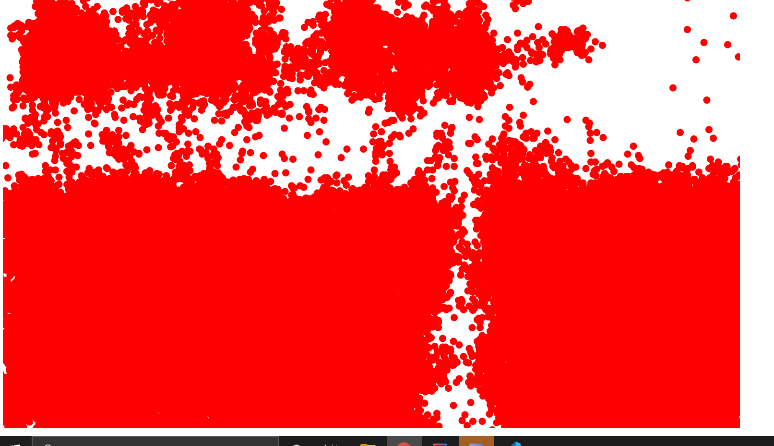
Finding divisions

Slide 13
Planned visualization Divide the screen into quadrants

Slide 14
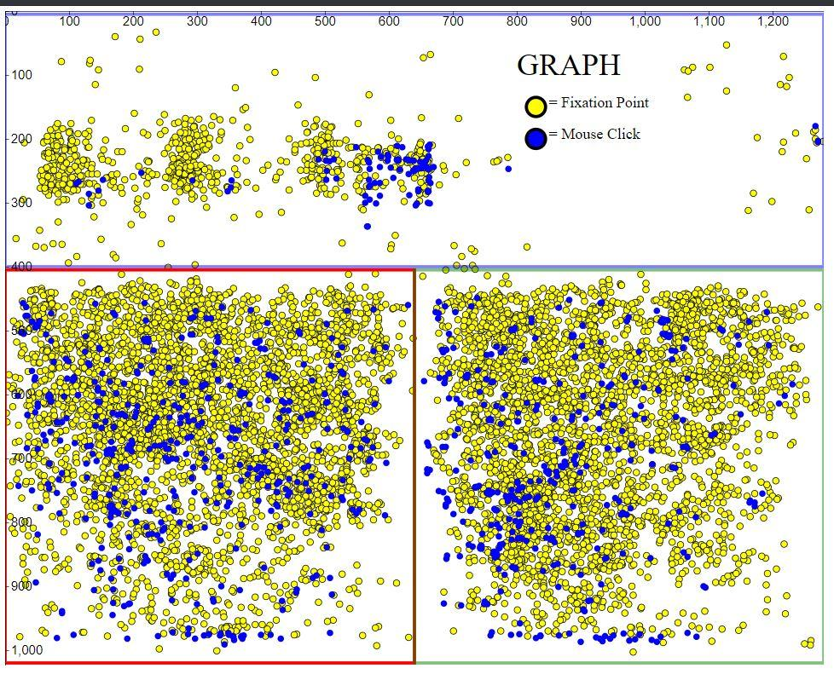
Combined View of Fixation Points and Mouse Clicks

Slide 15
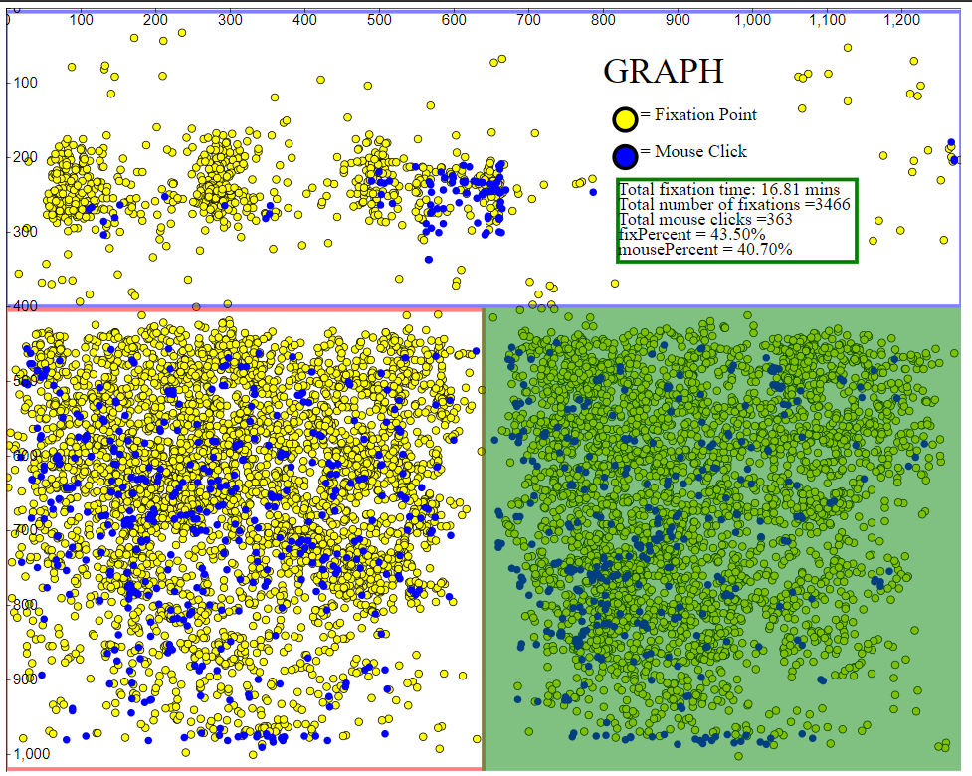
Which quadrants have more clicks/fix and percent?

Slide 16
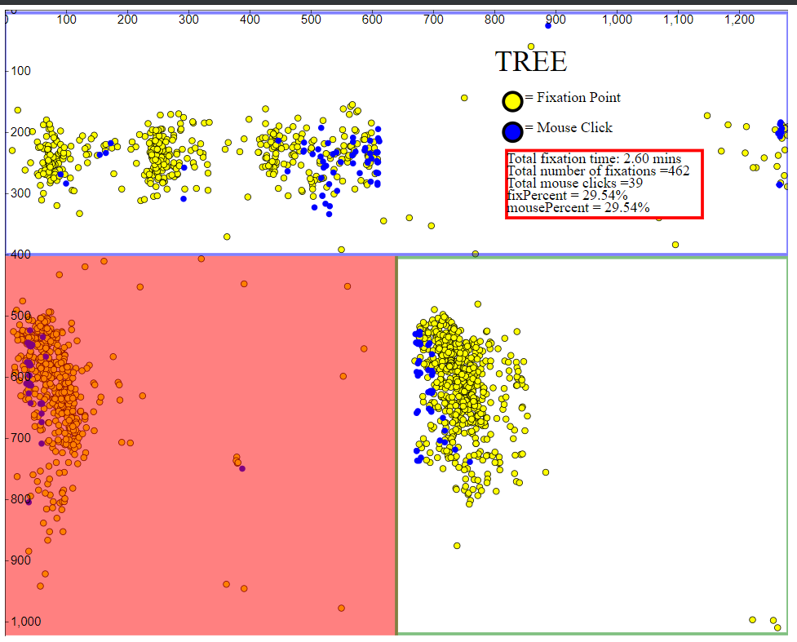
Which quadrants have more clicks/fix and percent?

Slide 17
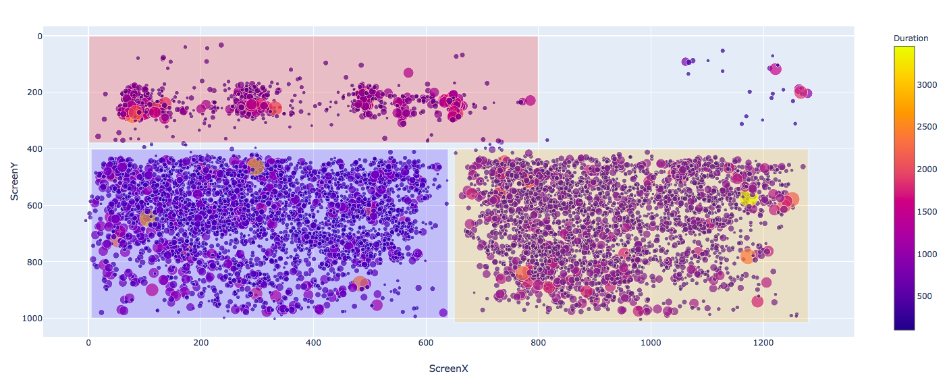
3.a In which quadrants, does the fixation points lie the most? (Graph)
Each quadrant has fixation points based on their duration. The bottom left has more fixation points with more duration than the rest.

Slide 18
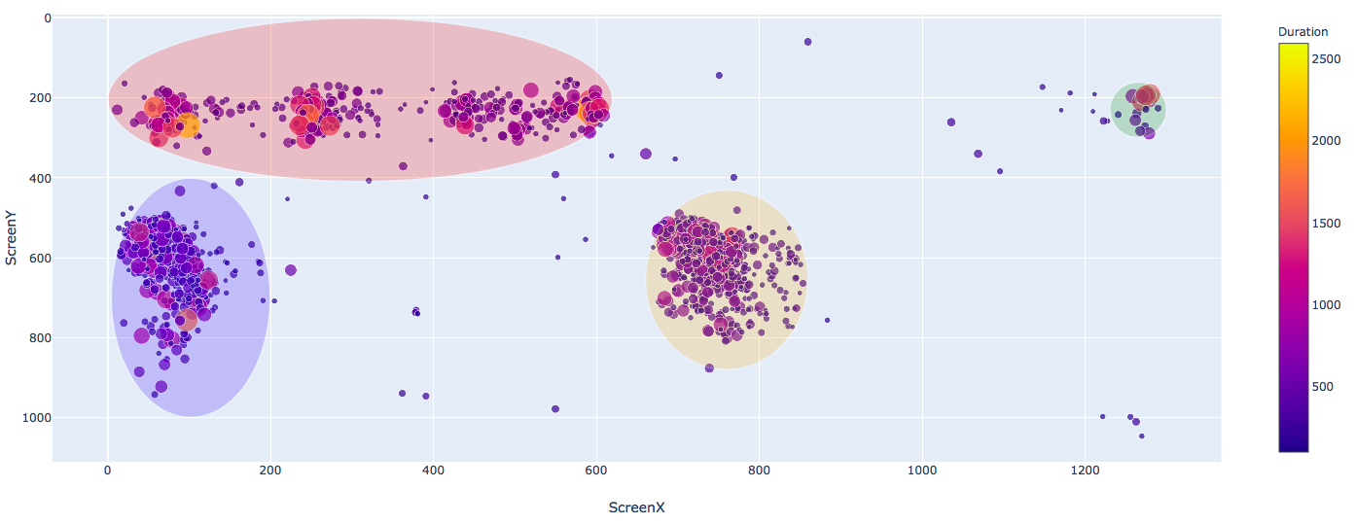
3.b In which quadrants, does the fixation points lie the most? (Tree)
Each cluster has fixation points based on their duration. The clusters were created using Clustering technique in plotly.

Slide 19
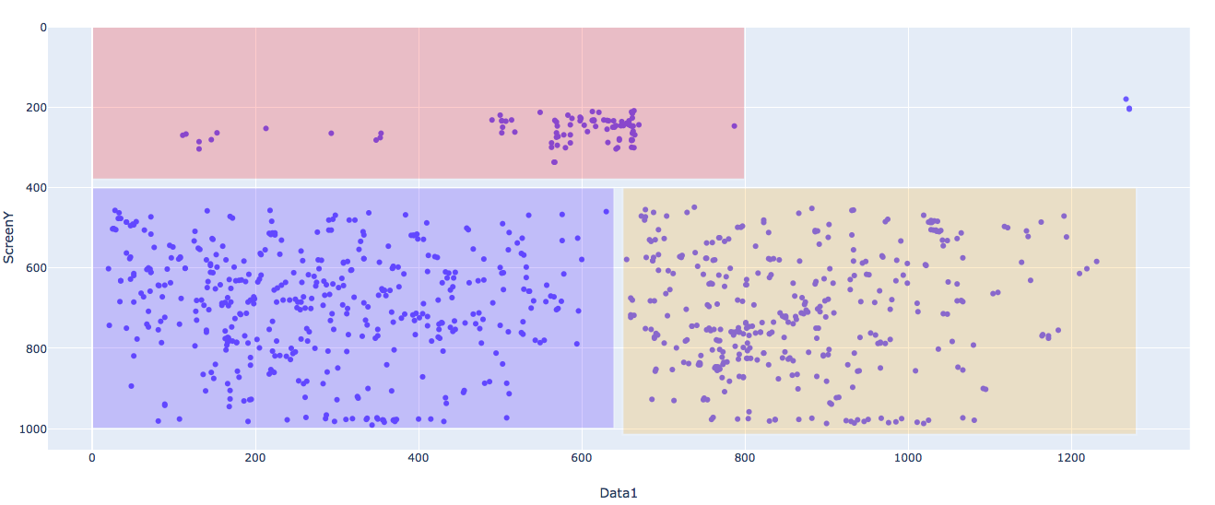
4.a Which quadrant has more click events? (Graph)
Each quadrant has click events. The bottom left has more click events than the rest.

Slide 20
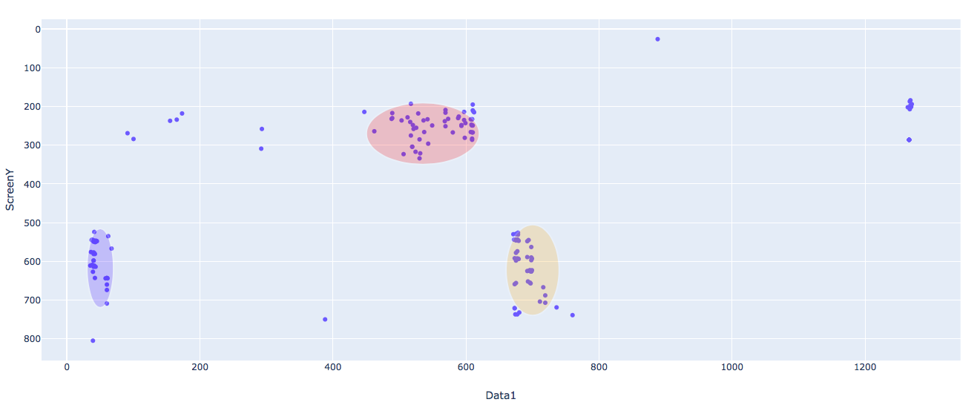
4.b Which quadrant has more click events? (Tree)
Each cluster has click events. The top cluster has more click events than the rest.

Slide 21
Contribution
Prateechi Singh | Questions Selection, Data Preprocessing, Generating graphs through Plotly, Presentation
Aniruddha Bhagwan Shinde, | Questions Selection, Generating graphs through Plotly, Presentation
Celeste Angelique Tubon | Questions Selection, Graphs explorations
Javier Sanchez | Questions Selection, Generating graphs through D3.js
Marcos Samuel Rodriguez | Questions Selection, Generating graphs through D3.js, Presentation

Slide 22
THANK YOU

